Slide 1
Machine Translation-Enabled Sentiment Analysis Across Multiple Languages Sushant Menon ,Vishwas Shivakumar
INFO-I 513 – Usable AI
INDIANA UNIVERSITY BLOOMINGTON

Slide 2
Introduction
Machine Translation-Enabled Sentiment Analysis is a technique that combines machine translation and sentiment analysis to analyze sentiment across multiple languages. It involves translating text from one language to another and then analyzing the sentiment of the translated text.
The goal of this technique is to overcome language barriers and enable businesses to gain insights into customer sentiment across multiple languages.
It uses Natural Language Processing (NLP) techniques to analyze text and identify sentiment
By using Machine Translation-Enabled Sentiment Analysis, businesses can better understand the sentiment of their customers in different languages, improve their communication with customers, and ultimately improve their bottom line.

Slide 3
Motivation
Globalization: Machine Translation-Enabled Sentiment Analysis can help businesses analyze customer sentiment across different languages and cultures, providing insights into the unique preferences and attitudes of each market.
Customer Experience: Understanding customers' sentiments can help businesses improve their products and services, as well as their overall customer experience. By identify areas for improvement, such as product features.
Competitive Advantage: By understanding customer sentiment in different regions, businesses can tailor their marketing and product strategies to meet the needs and preferences of each market.
Brand Reputation: Negative sentiment expressed by customers can damage a business's reputation, regardless of the language in which it is expressed. This can help businesses identify and address negative sentiment across multiple languages, protecting their brand reputation and improving customer satisfaction.

Slide 4
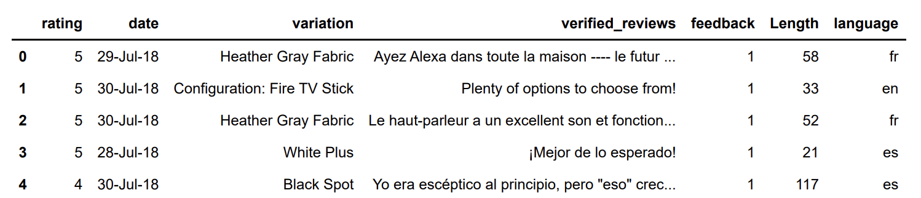
About the Data
Data : - https://www.kaggle.com/datasets/sid321axn/amazon-alexa-reviews
This dataset consists of a nearly 3000 Amazon customer reviews (input text), language ,star ratings, date of review, variant and feedback of various amazon Alexa products.
The dataset contains reviews in three different languages, French, Spanish, English. Which will be translated using Deep-translator for further analysis.

Slide 5
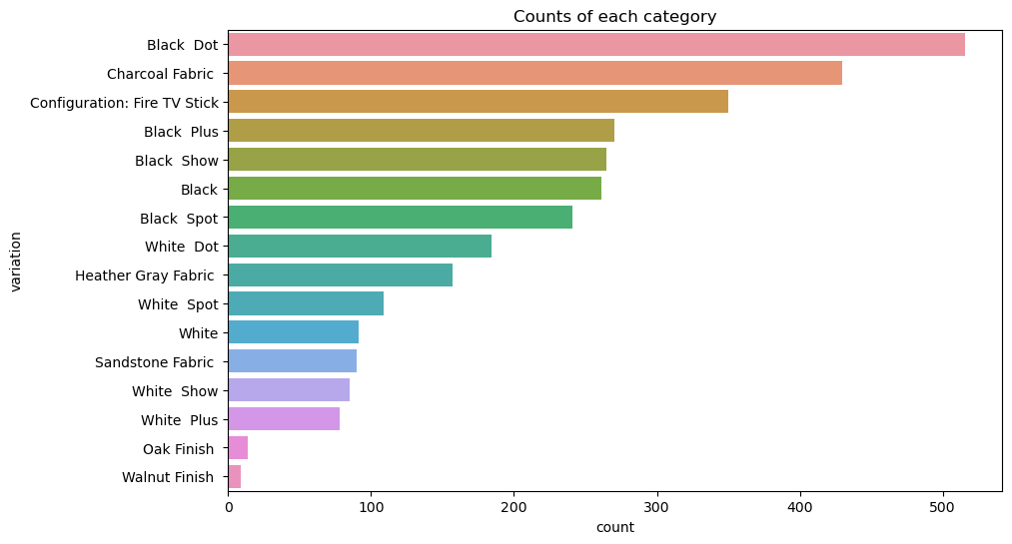

Slide 6
Deep-Translator
Deep-translator is an open-source Python library that provides a simple and flexible interface to access several popular machine translation APIs, including Google Translate, Microsoft Translator, and more.
With deep-translator, businesses can leverage the power of machine translation to automatically translate text into multiple languages. This can save time and resources.
The library can handle the translation of text in over 50 languages, including English, French, Spanish, Chinese, Japanese, and more.
The use of deep-translator in Machine Translation-Enabled Sentiment Analysis workflows can improve the accuracy and consistency of translations, as it provides access to multiple machine translation APIs

Slide 7
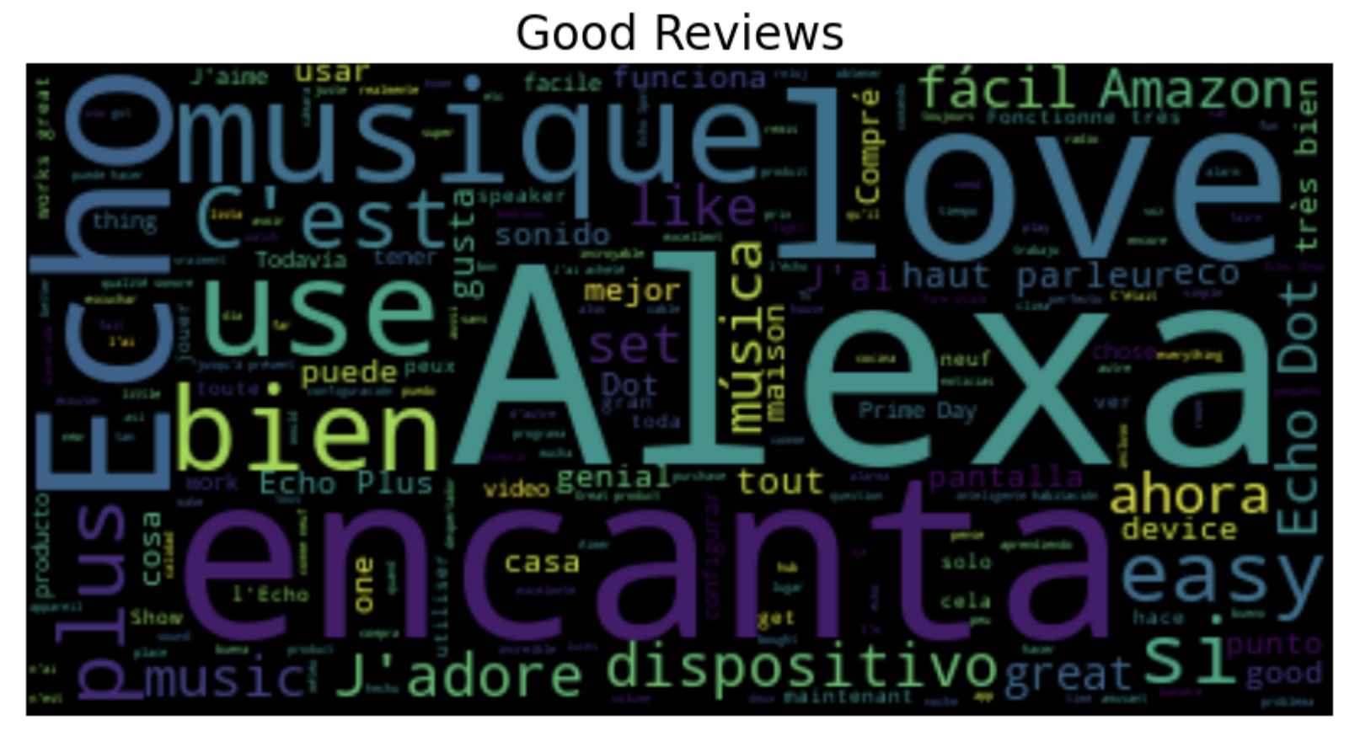
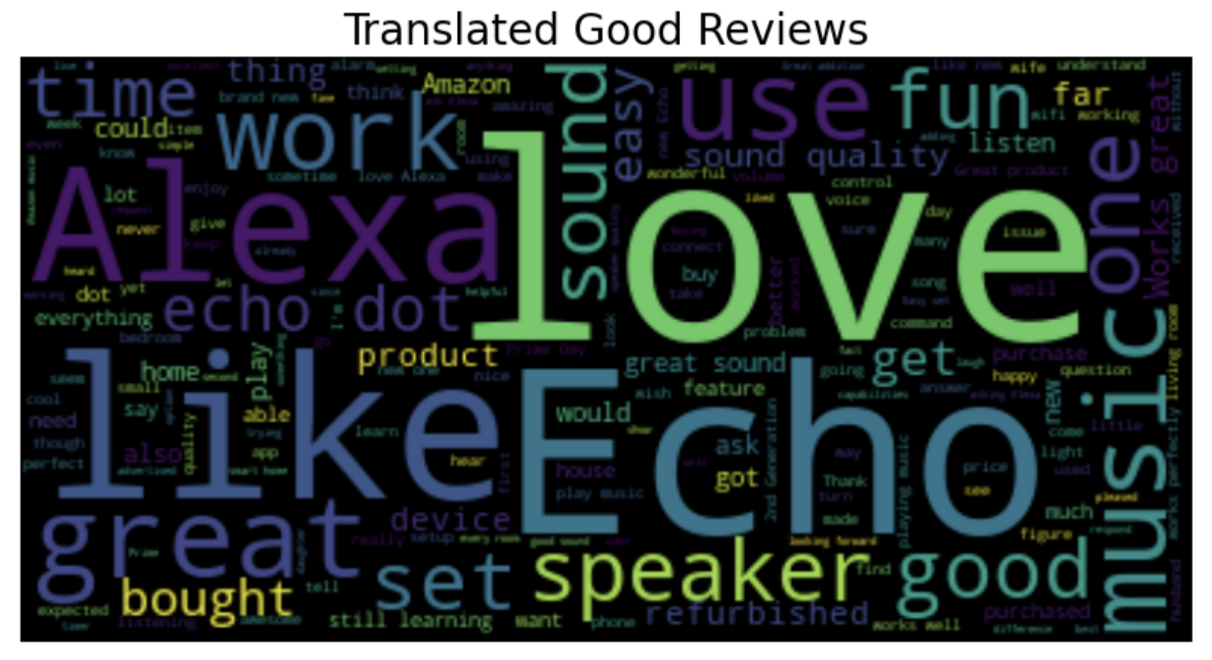
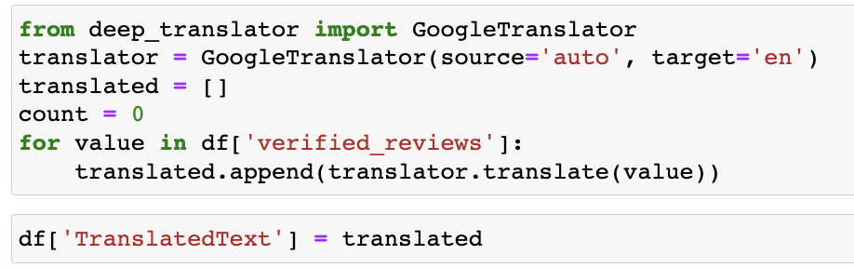
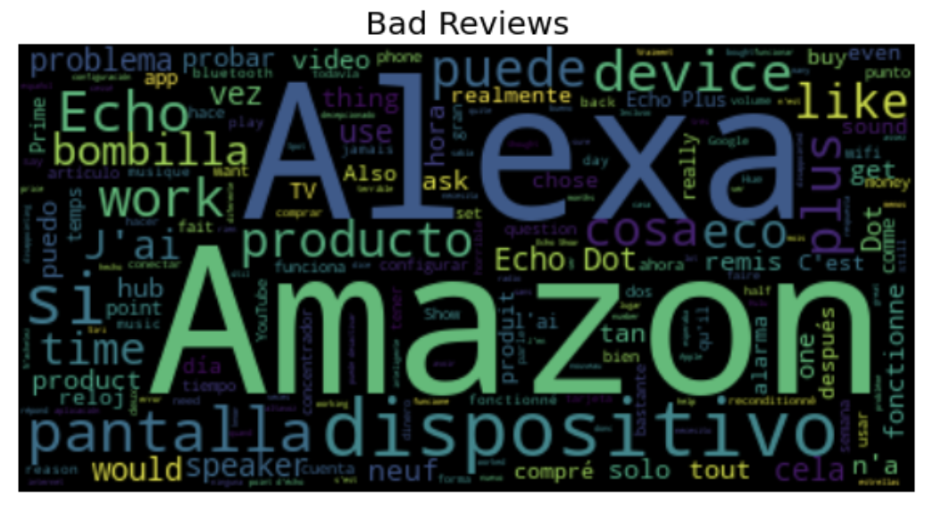
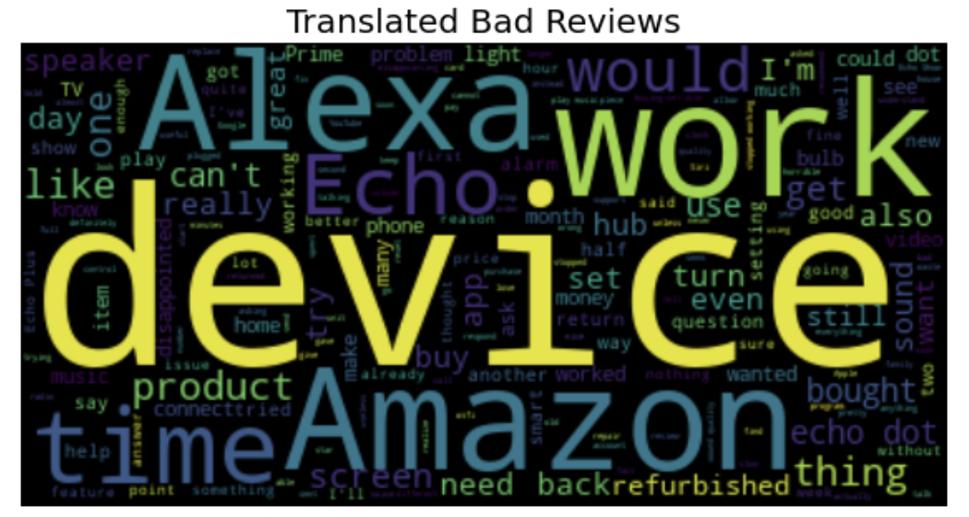
Translation

Slide 8
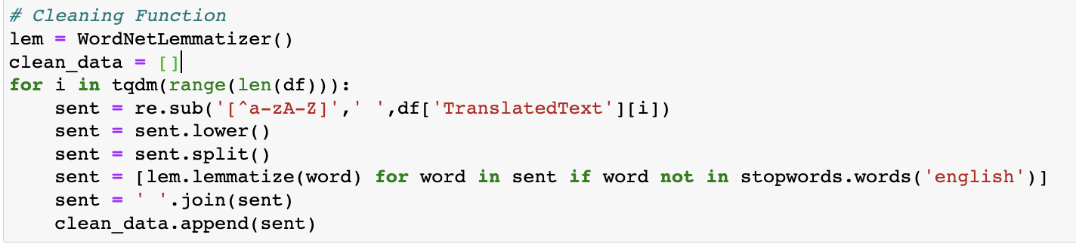
Preprocessing
Remove all URLs, hashtags.
Remove all the emoticons
Remove all punctuations, symbols, numbers
Remove Stop Words.
Lemmatizing.

Slide 9
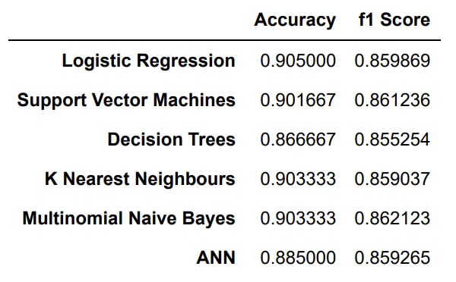
Models Trained
Logistic Regression
Support Vector Classifier (SVC)
Decision Tree Classifier
Multinomial Naïve Bayes
K-Nearest Neighbors (KNN) Classifier
Artificial Neural Networks (ANN)

Slide 10
Pre-built Model (VADER)
VADER (Valence Aware Dictionary and sentiment Reasoner) is a pre-built sentiment analysis model developed by researchers at the Georgia Institute of Technology. It is specifically designed to analyze sentiments in social media text, such as tweets, posts, and comments.
The VADER model uses a combination of rule-based heuristics and machine learning algorithms to determine the polarity of a text, i.e., whether it expresses positive, negative, or neutral sentiment.
It also takes into account the intensity of the sentiment, as well as the presence of positive and negative words, emoticons, and punctuation marks that are commonly used in social media.

Slide 11
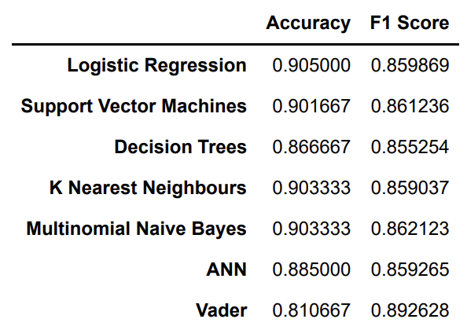
Comparing Performances of Both

Slide 12
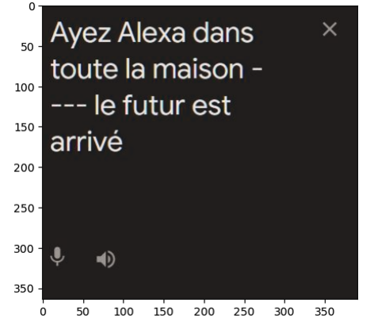
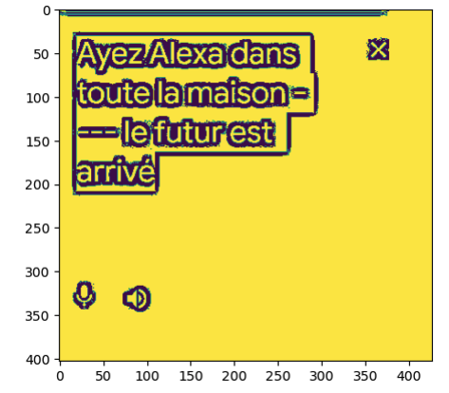
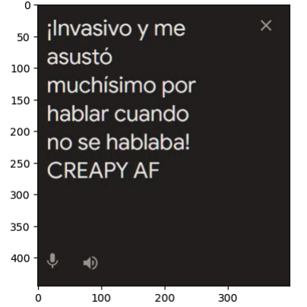
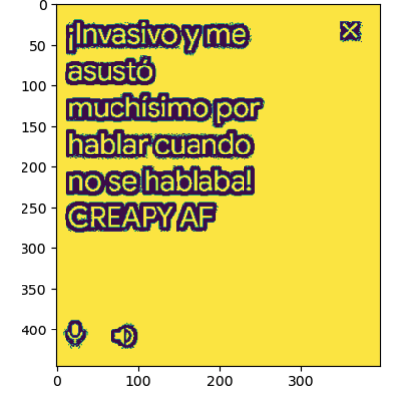
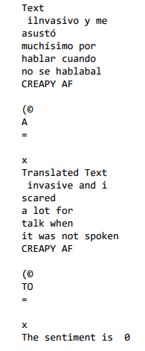
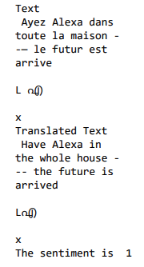
MT- Enabled Sentiment analysis using VADER and PyTessaract(OCR)

Slide 13
Future Scope
Create a webapp which allows users to upload text or image with text in a different language to translate.
Improve VADER and PyTessaract to know the sentiment of a text in the images from social media or otherwise.

Slide 14
References
Amazon Alexa Reviews. (2018, July 31). Kaggle. https://www.kaggle.com/datasets/sid321axn/amazon-alexa-reviews
Bird, S., Klein, E., & Loper, E. (2009). Natural language processing with Python: analyzing text with the natural language toolkit. "O'Reilly Media, Inc.".
FastAPI contributors. FastAPI: FastAPI framework, 2021. Available: https://fastapi.tiangolo.com/.
Streamlit contributors. Streamlit: The fastest way to build data apps, 2021.Available: https://streamlit.io/.
Tesseract OCR. "GitHub", 2021. Available: https://github.com/tesseract-ocr/tesseract.
Vader Sentiment Analysis. "GitHub", 2021. Available: https://github.com/cjhutto/vaderSentiment.
googletrans. (2020, June 14). PyPI. https://pypi.org/project/googletrans/
Brownlee, J. (2020, March 16). An Introduction to Neural Machine Translation. Machine Learning Mastery. https://machinelearningmastery.com/introduction-neural-machine-translation/
Deutscher, O. (2020, November 24). Neural Machine Translation: An Introduction. Phrase Blog. https://phrase.com/blog/posts/neural-machine-translation/
Singh, S. (2021, March 9). How to Extract Text from Images with Python? GeeksforGeeks. https://www.geeksforgeeks.org/how-to-extract-text-from-images-with-python/
Keung, P., Lu, Y., Szarvas, G., & Smith, N. A. (2020). The Multilingual Amazon Reviews Corpus. In Empirical Methods in Natural Language Processing. https://doi.org/10.18653/v1/2020.emnlp-main.369
deep-translator. (2023, February 16). PyPI. https://pypi.org/project/deep-translator/

Slide 15
Thank you!

